Slide 1
E-Commerce Presentation
Prepared By Muhammet Nar

Slide 2
Used Technologies
.Net Core Mvc
Entity Framework
C# Programming Language
Ms Sql Server
Javascript
Jquery
Ajax
Json
Linq
Restfull
Bootstrap
Html
Css

Slide 3
How it was developed?
The project is made with a multi-layered(Business, Data Access, Entities, Web Ui) software architecture.
It is developed on the Core software development platform.
MVC(Model, Controller, View) architecture is used.
It is developed using the Entity Framework ORM tool.
MSSQL is preferred as the database.

Slide 4
What is the purpose of the project?
My project was made to create a fast, user-friendly, reliable e-commerce project.
While developing the project, latest .Net technologies were tried to be used.
Easy to use was my biggest goal.
It was one of my goals to be compatible on Web and Mobile.

Slide 5
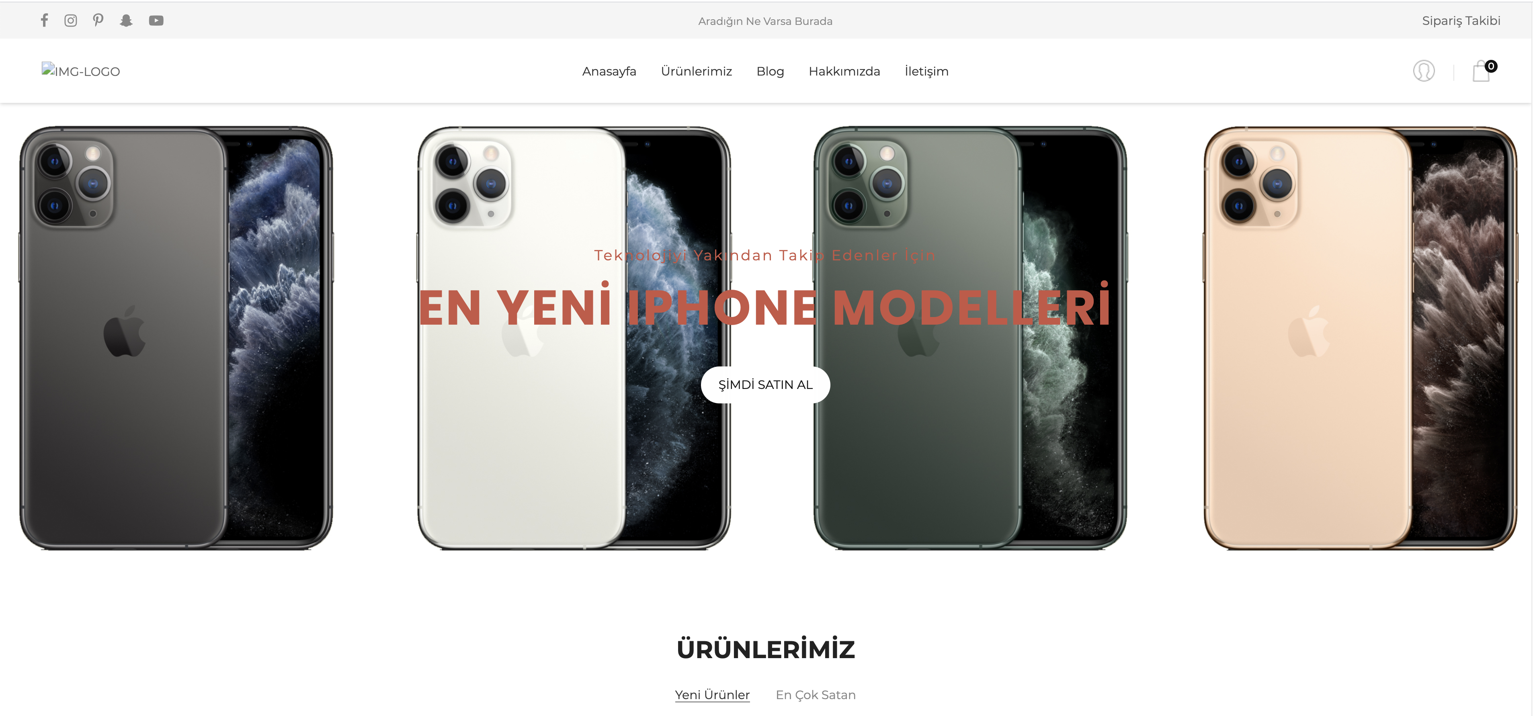
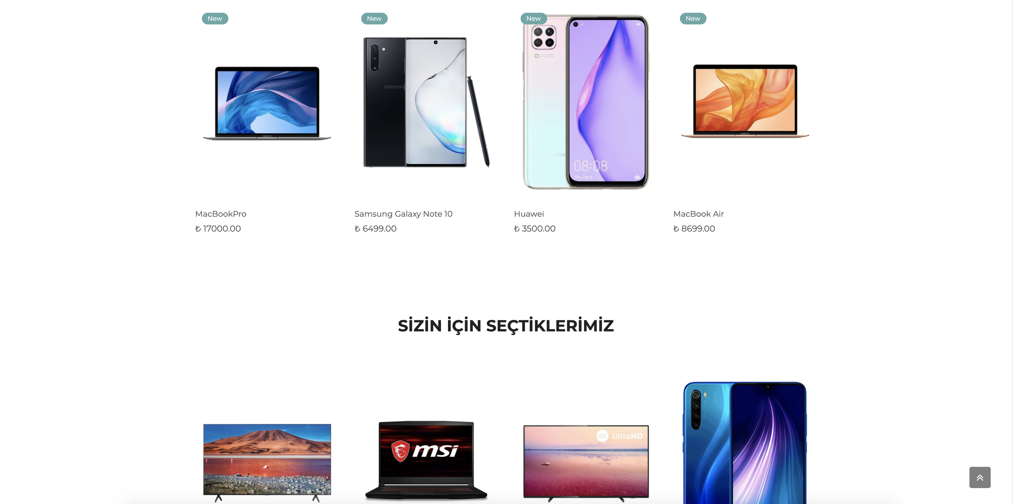
Homepage
When the homepage is opened for the first time, it welcomes us with a slider. We also show you the newest added, best selling and featured products for our customers.

Slide 6
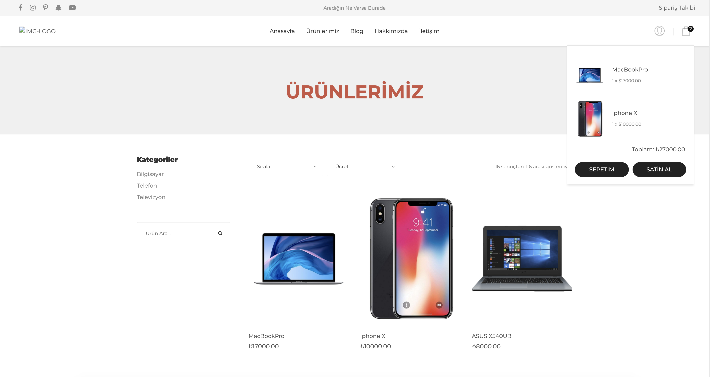
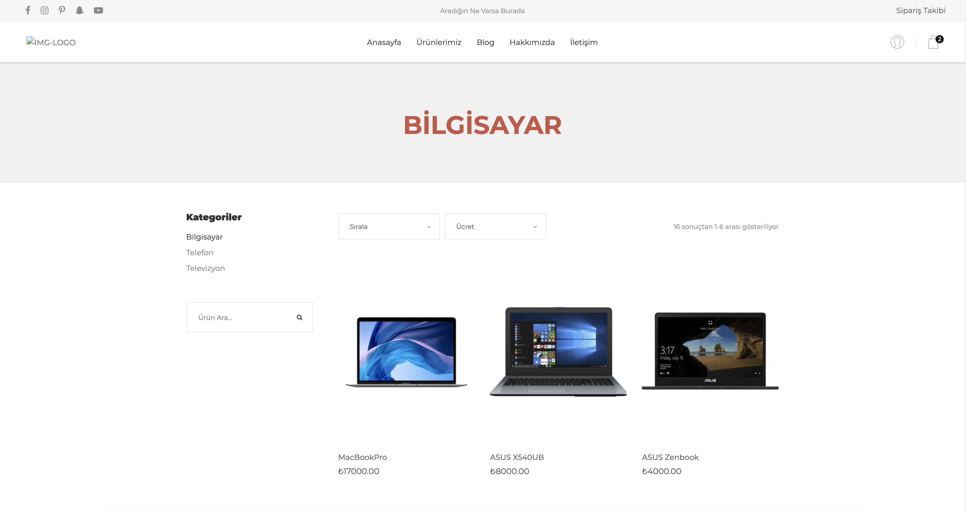
Products Page
Products Page(Computer Category)
Our products are listed on this page. Paging has been done using model binding. Products added to the basket look like the top right hand corner when the cart icon is clicked.
When any category is selected, only the products of the selected category are listed.

Slide 7
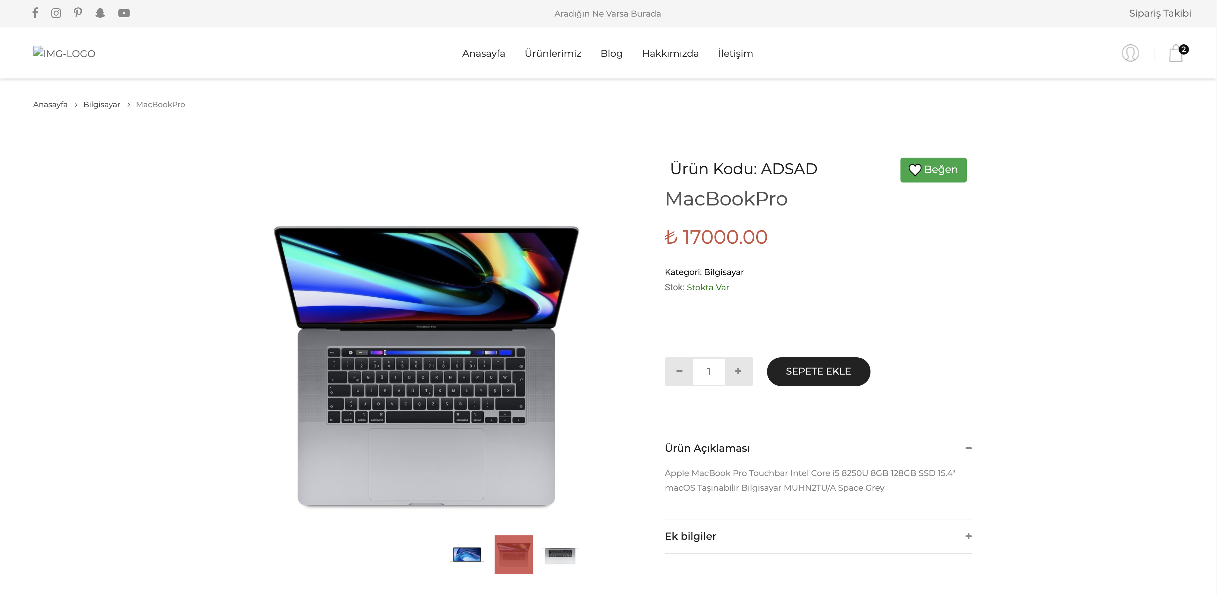
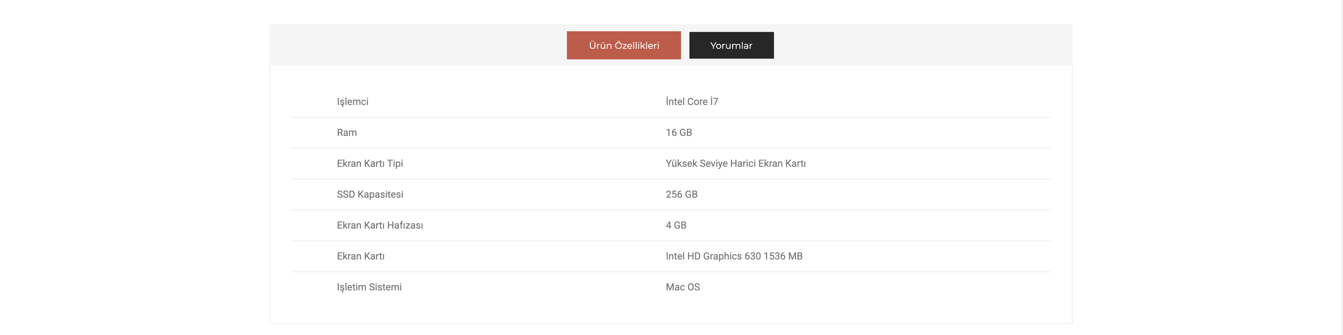
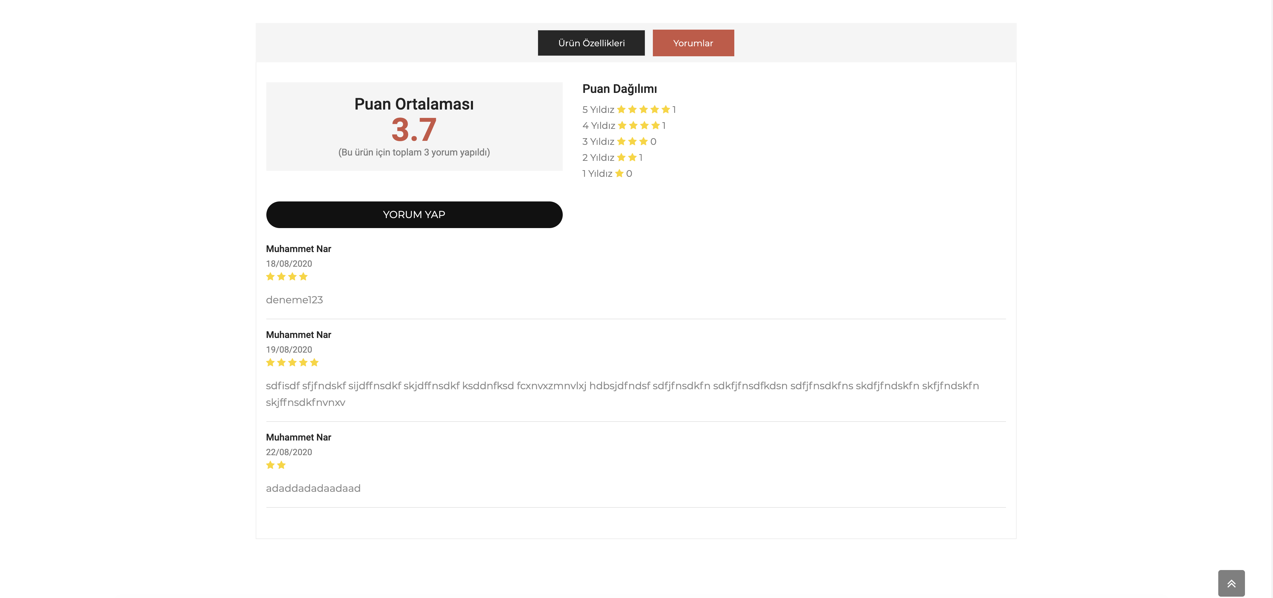
Product Detail Page
When the product detail page opens, the features of the product are shown. User can add any number of products to the cart from here. You can see the details of the product at the bottom of the page. If the user is registered in the system, he / she may like the product. If the user has purchased this product more than once, he / she can comment on the product.
When clicking on the Comments button, the comments made and the points given to the product are shown.

Slide 8
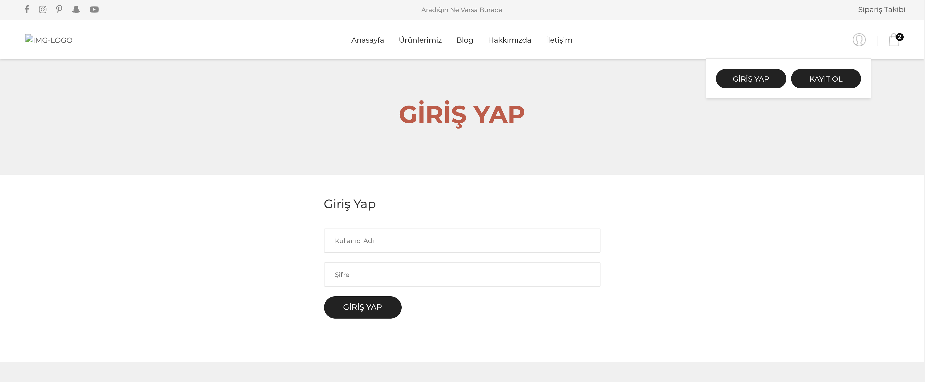
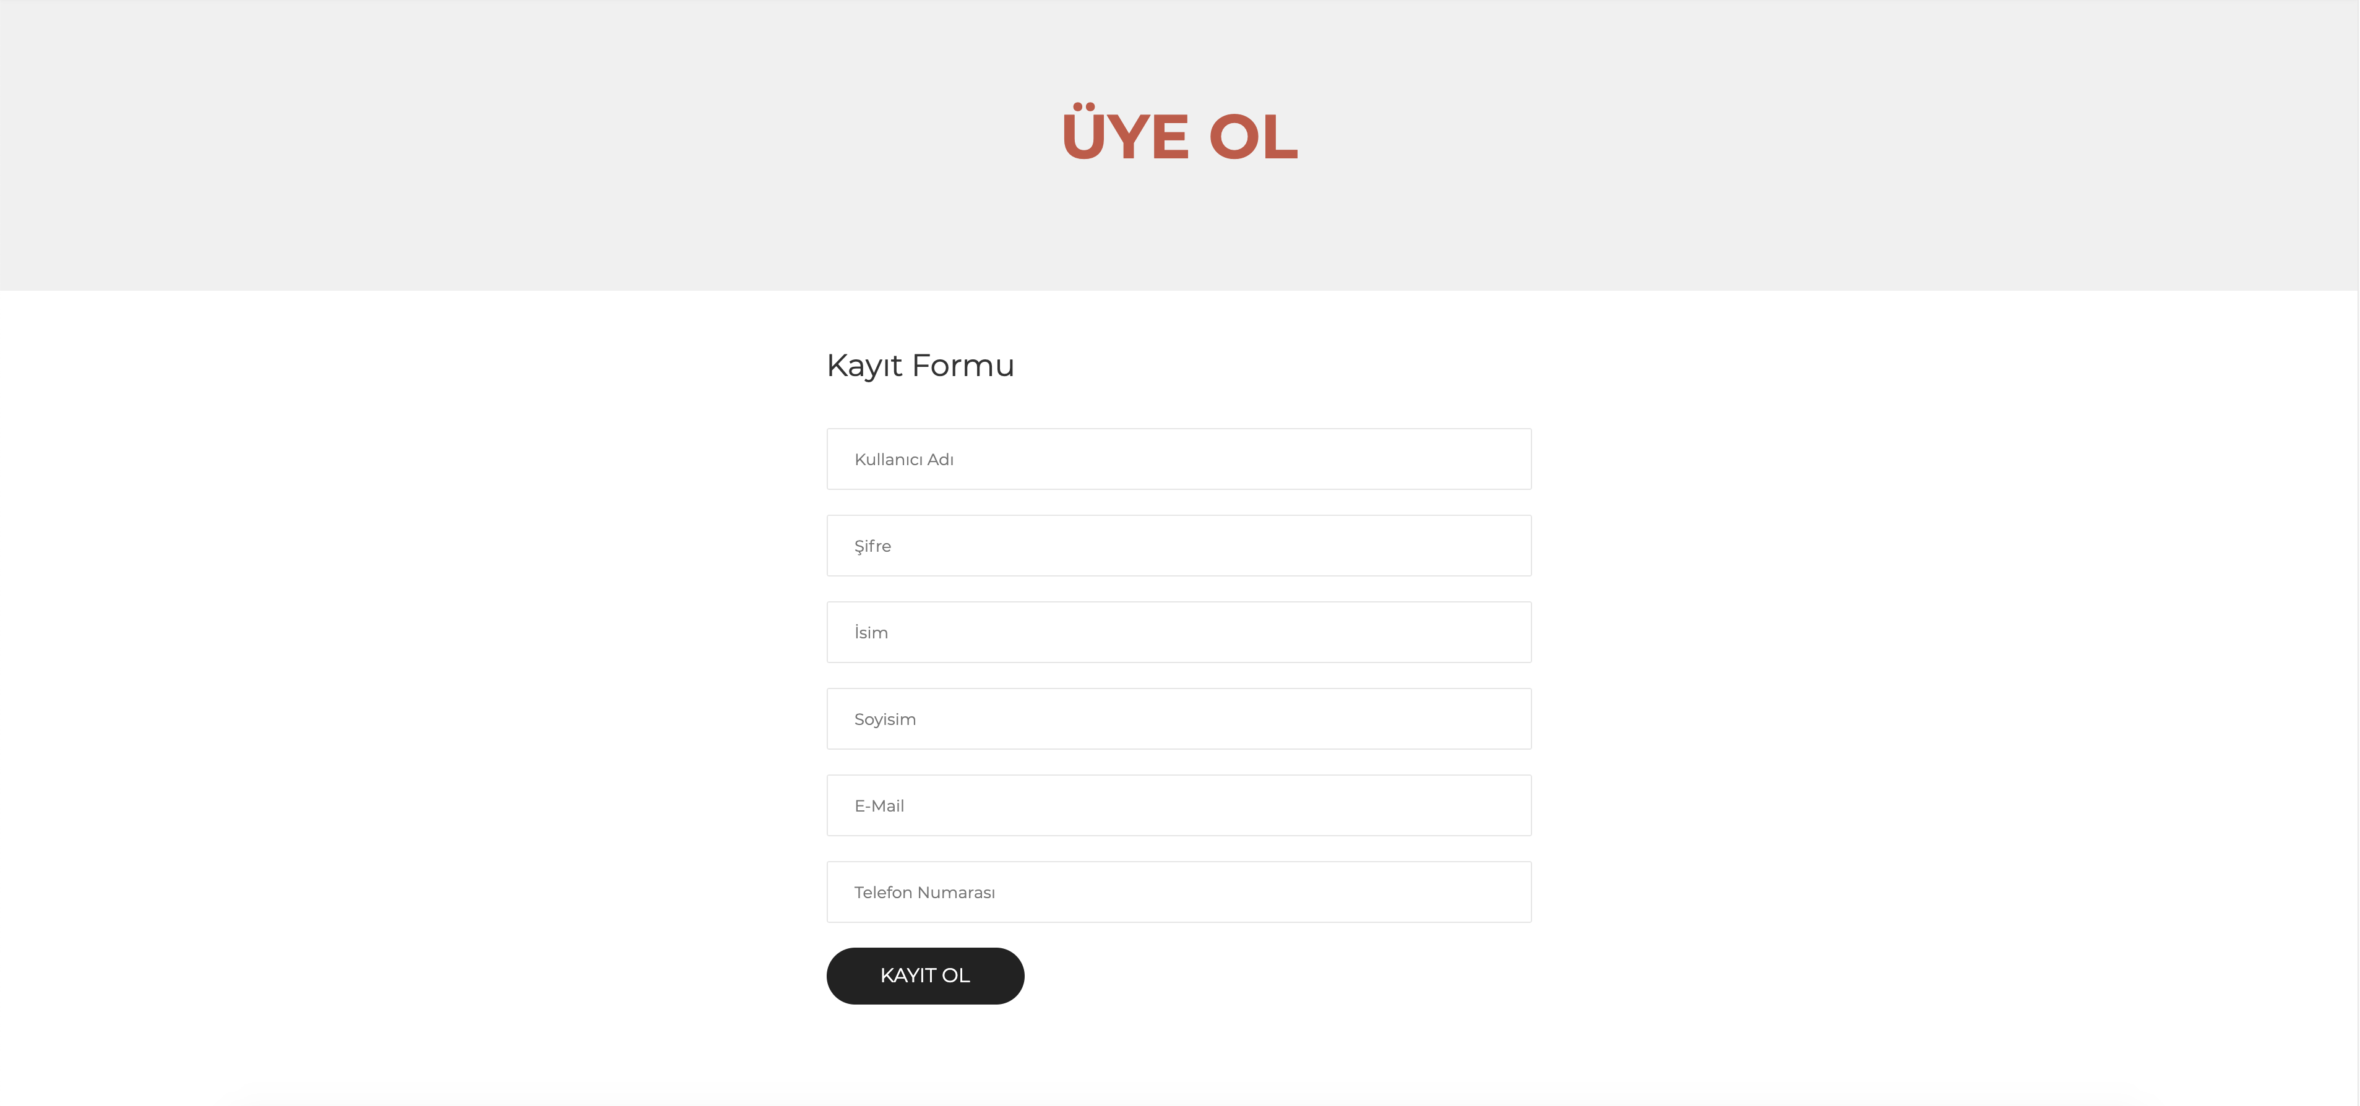
SignIn Page
Users can login to the system from this page and they can begin manage their account.
SignUp Page
If users are not registered to the system, they can register to the system by filling the required fields on this page.

Slide 9
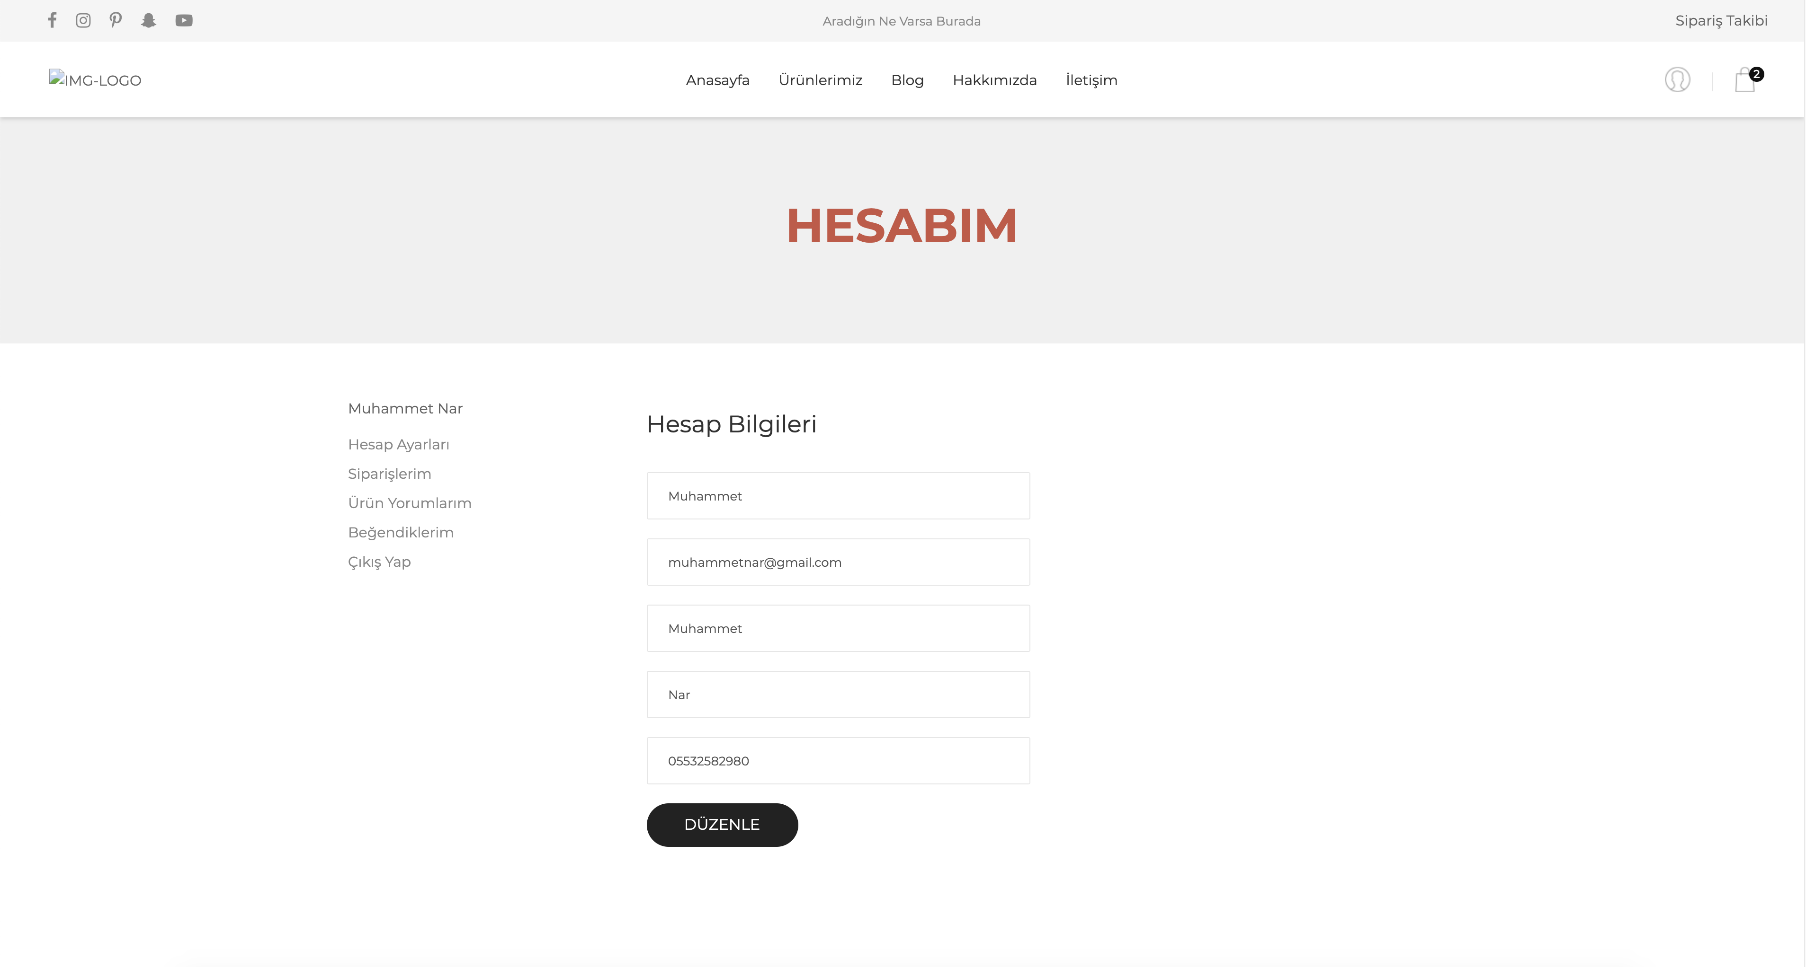
Account Settings Page
Users can change their personal information from the account settings page.

Slide 10
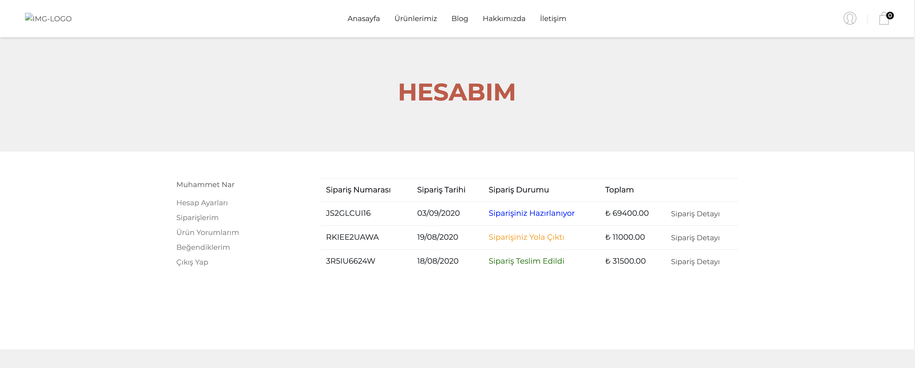
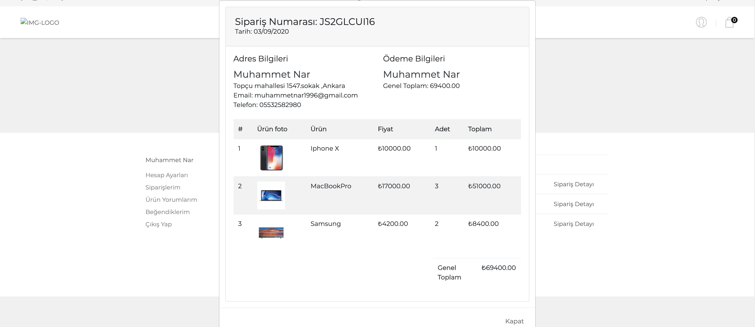
Orders Page
All orders made are shown on the my orders page.
When the order details button is clicked, the details of the order made are displayed.

Slide 11
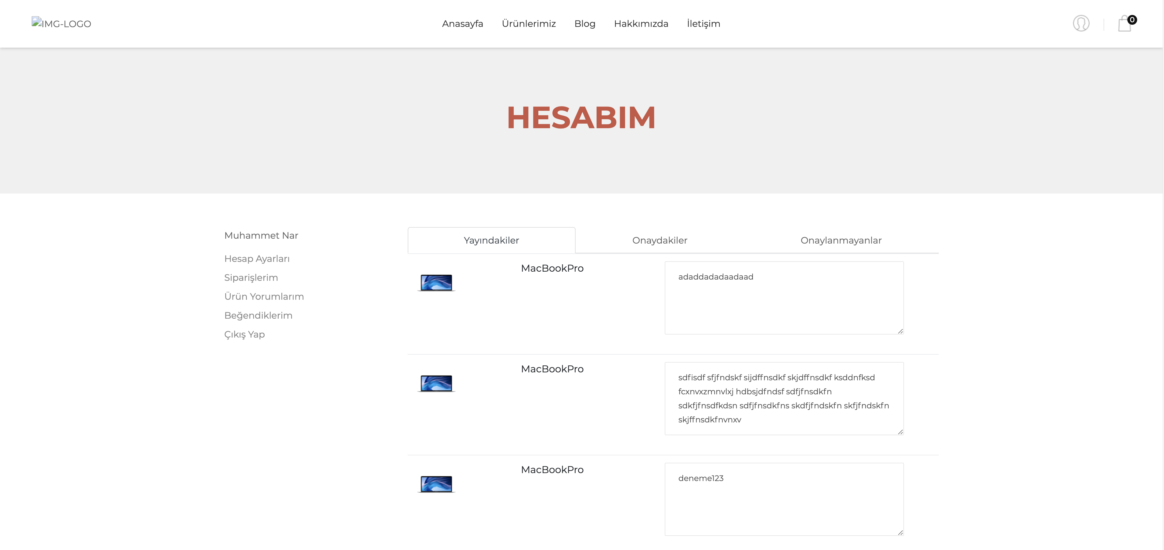
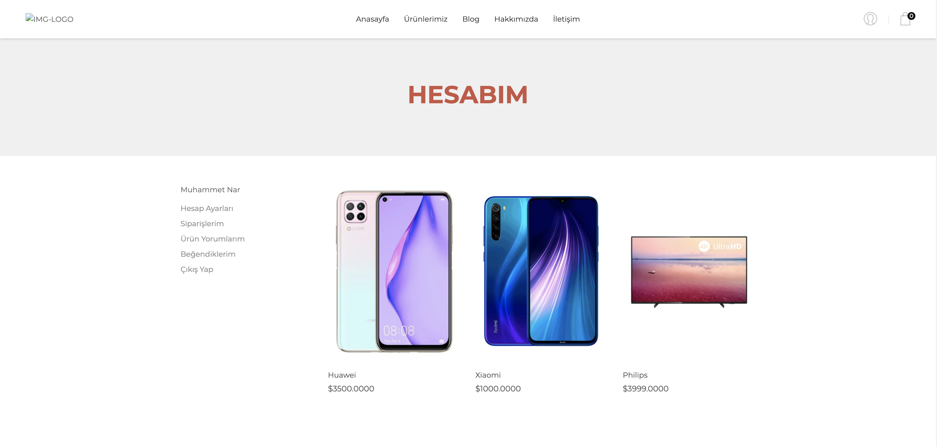
Comment Page
Favorite Page
The comments made by the user to the products are shown. Pending approval, rejected comments, and posted comments are shown separately.
User's liked products are shown.

Slide 12
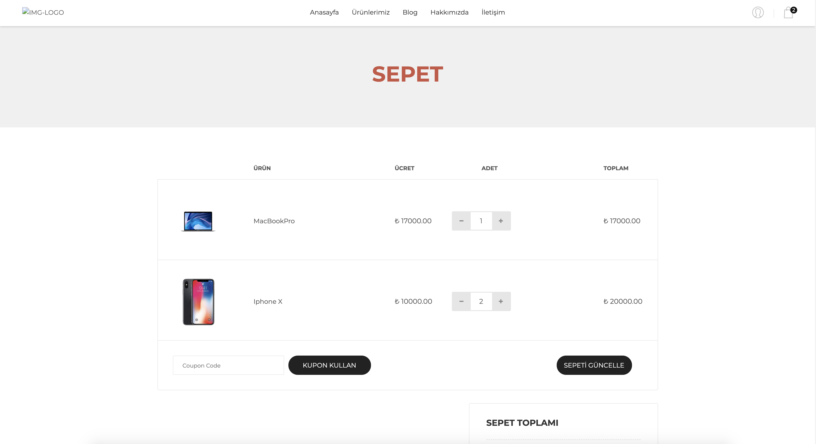
Cart Page
The products that the user has added to the cart are displayed on the cart page. If the user wishes, they can update the number of products here. If they have a coupon code, they can use it to get a discount.

Slide 13

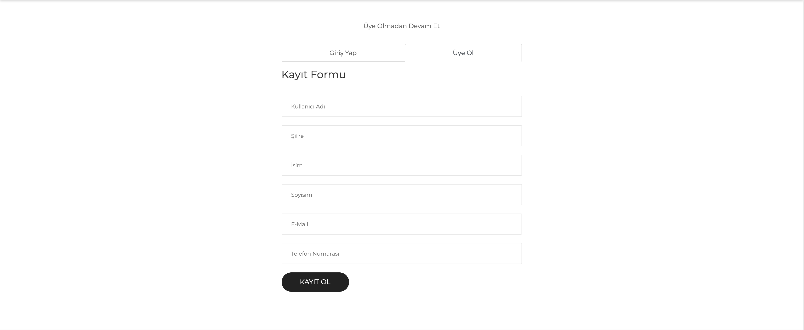
When going to the purchasing page, system will ask the user the question "would you like to continue by logging in".
If the user does not have an account, they can be register here and the process can continue.
In addition, the purchasing process can be continue without registration.

Slide 14
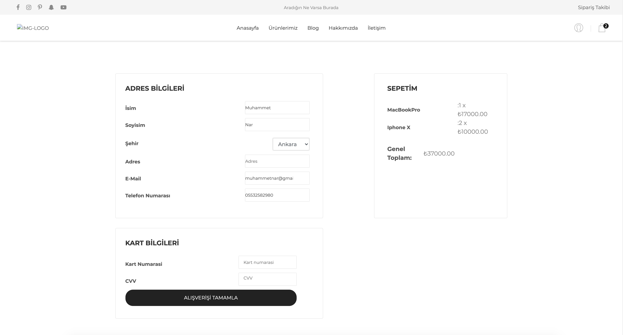
CheckOut Page
If the user came to this page by logging in, the relevant fields will be filled as in the account.
The products in the cart are listed on the right side.
When the buy button is clicked, the purchasing process will be completed.

Slide 15
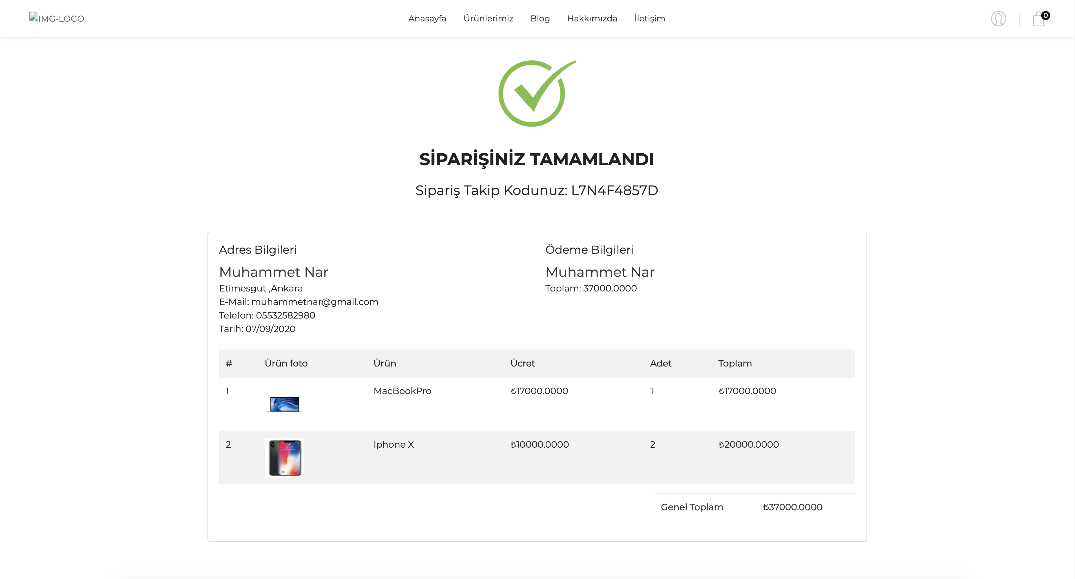
Order Summary Page
When the purchase is complete, an order summary will be shown.

Slide 16
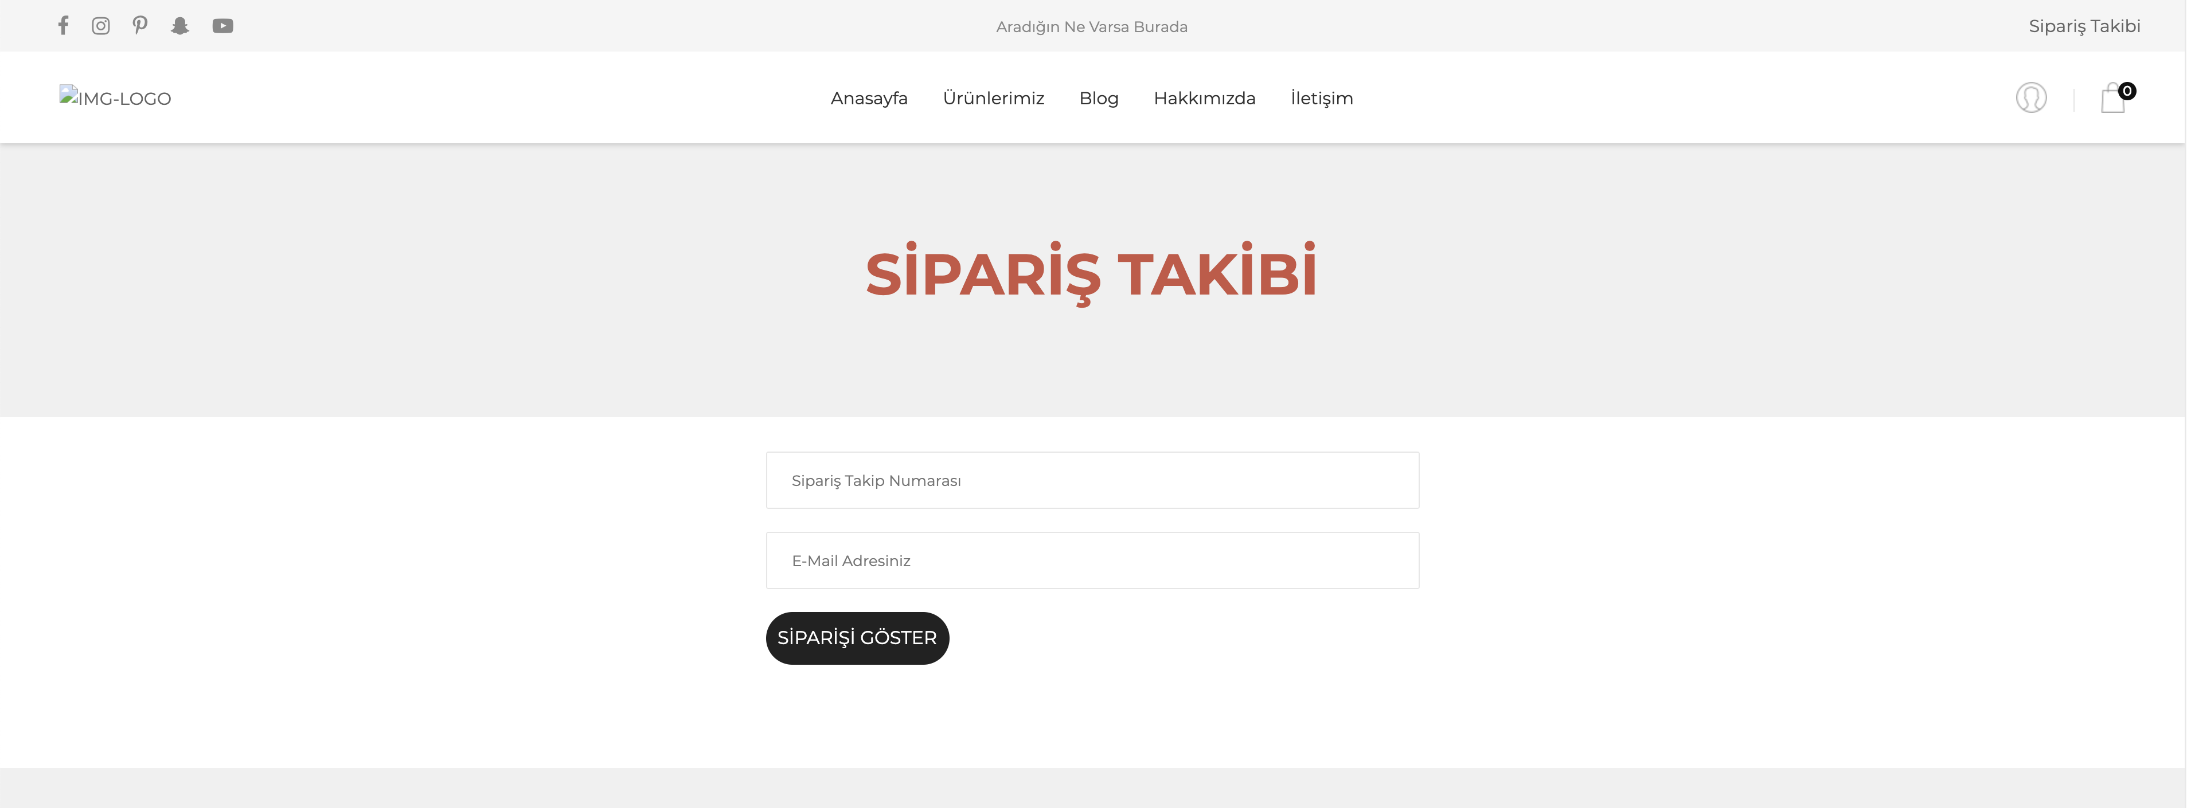
Order Inquiry Page
If users are not registered in the system, they can track the status of the order using the order code.

Slide 17
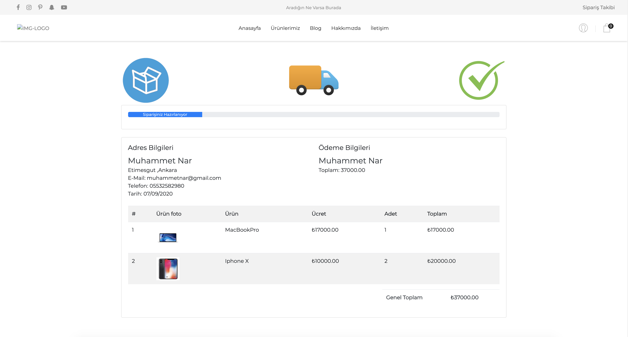
Order Status Page
After the inquiry is made, the page showing the status of the order and the order details will open.

Slide 18
Important Notes
The admin panel of the project is not included in the slide.
The fine details of the project could not be displayed in the slide show (details for commenting, adding to favorites etc.).
The project continues to develop.
If necessary, an online or one-to-one presentation will be made.

Slide 19
What's Next?
To make the categories more detailed, to add sub-categories.
Filtering feature to search for products better.
Making front-end improvements.
Etc.

Slide 20
Thanks for Reviewing

